Slide 1
Document Object Model
The Document Object Model (DOM) is an Application Programming Interface (API) for HTML and XML documents.
With the Document Object Model, programmers can create and build documents, navigate their structure, and add, modify, or delete elements and content.
The DOM is an object-oriented representation of the web page, which can be modified with a scripting language such as JavaScript.
The DOM model represents a document with a logical tree.
According to Document Object Model (DOM), every HTML-tag is an object. Nested tags are called “children” of the enclosing one. All operations on the DOM start with the document object. From it we can access any node.
The Document Object Model can be used with any programming language.

Slide 2
DOM Levels
DOM Level 0 – This level supports the common document object collections – form[ ], image[ ], anchors[ ], links[ ] and applets[ ]. This is also known as classic or traditional JavaScript Object Model.
DOM Level 1- It provides the ability to manipulate all elements in a document through a common set of function. In this level all elements are exposed and parts of the page can be read and written to at all times.
DOM Level 2 – It provides further access to page elements primarily related to CSS and focuses on combining Level 0 and Level 1 while adding improved support for working with XML documents.

Slide 3
DOM Levels
DOM Level 3 – Enhanced Level of Level 1 and Level 2 and added support for XPath and keyboard event handling.
DOM Level 4 – Enhanced year 2015

Slide 4
Categories of DOM
DOM Core – It specifies a generic model for viewing and manipulating a marked up document as a tree structure.
DOM HTML – It specifies an extension to the core DOM for use with HTML. This represents DOM Level 0 with capabilities for manipulating all of the HTML element objects.
DOM CSS – It specifies the interfaces necessary to manipulate CSS rules programmatically.
DOM Events – It adds event handling to the DOM.
DOM XML – It specifies an extension to the Core Dom for use with XML.

Slide 5
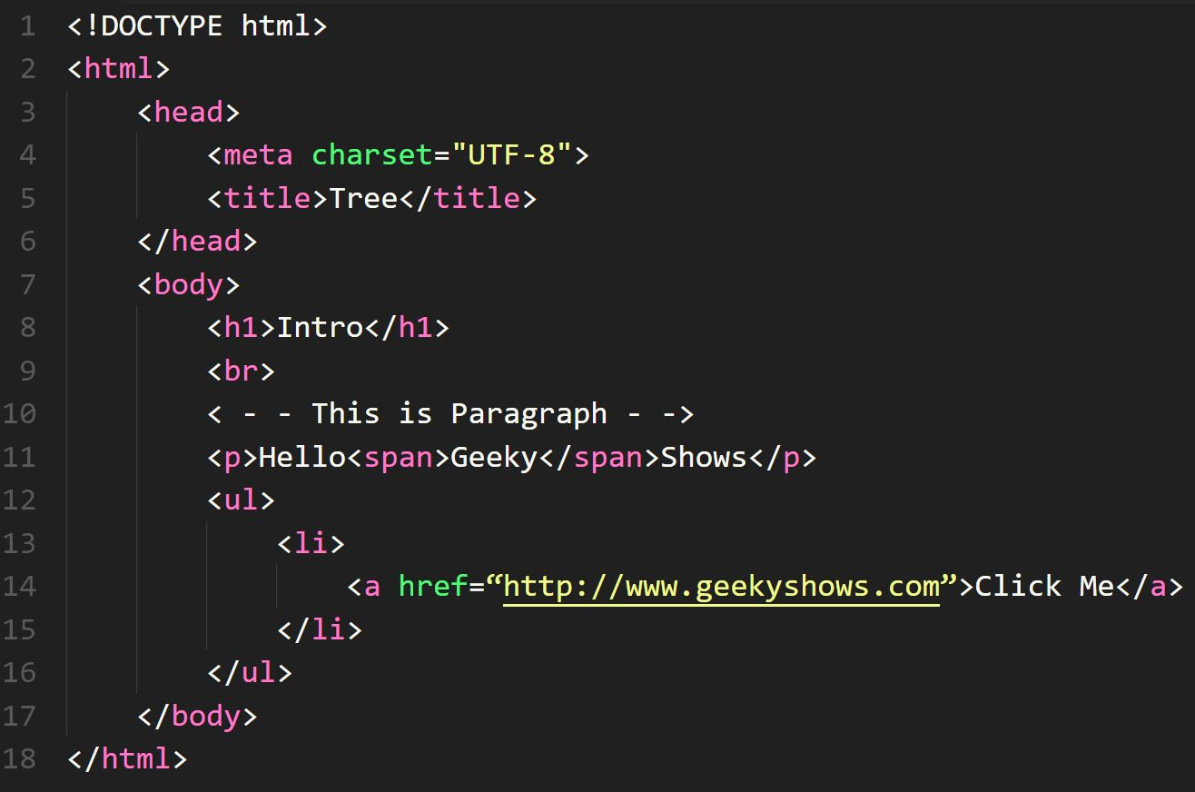
Document Tree
Root <html>
Element <head>
Element <body>
Element <meta>
Element <title>
Element <h1>
Element <br>
Element <p>
Element <ul>
Element <li>
Element <a>
Text “Tree”
Text “Intro”
<- - - ->
Text “Hello”
Element <span>
Text “Shows”
Text “Geeky”
Text “Click Me”
Attribute
href

Slide 6
Root <html>
Element <head>
Element <body>
Element <meta>
Element <title>
Element <h1>
Element <br>
Element <p>
Element <ul>
Element <li>
Element <a>
Text “Tree”
Text “Intro”
<- - - ->
Text “Hello”
Element <span>
Text “Shows”
Text “Geeky”
Text “Click Me”
Document
Element
Node
Element
Node
Comment
Node
Attribute
href
Text
Node
Attribute
Node
Text
Node

Slide 7
DOM Node Types
Constant | Node Type | Description
Node.ELEMENT_NODE | 1 | An element such as <h1> or <div>
Node.TEXT_NODE | 3 | The actual Text of Element or Attribute ex: - “Hello”
Node.PROCESSING_INSTRUCTION_NODE | 7 | An instruction to a parser on aspect of the document <?xml version=“1.0”?>
Node.COMMENT_NODE | 8 | A comment such as < - - Something - - >
Node.DOCUMENT_NODE | 9 | A Document Node
Node.DOCUMENT_TYPE_NODE | 10 | A doctype statement <!DOCTYPE html>
Node.DOCUMENT_FRAGMENT_NODE | 11 | A document fragment, which represents a lightweight structure to hold a collection of DOM nodes for manipulation or insertion.

Slide 8
Node Relationship
Parent
Children
First Child
Previous Sibling
Next Sibling
Last child
<html>
<head>
<body>
<h1>
<br>
<p>
<ul>
<li>
<a>
“Intro”
“Hello”
<span>
“Shows”
“Geeky”

Slide 9
DOM Node Properties
Properties | Description
nodeName | Contains the name of the node
nodeValue | Contains the value within the node; generally only applicable to text nodes
nodeType | Holds a number corresponding to the type of node
parentNode | Reference to the parent node of the element, if one exists
childNodes | Access to the list of child nodes
firstChild | Reference to the first child node of the element, if one exists
lastChild | Points to the last child node of the element, if one exists
previousSibling | Reference to the previous sibling of the node; for example, if its parent node has multiple children
nextSibling | Reference to the next sibling of the node; for example if its parent node has multiple children
attributes | The list of the attributes for the element
ownerDocument | Points to the HTML Document object in which the element is contained

